Slide 1
PLD Design and Constraint
Part 1
Course : CPEN6265010 Digital System
Effective Period : September 2025

Slide 2
Related LO
Learning Objectives
LO3: Utilize Hardware Description Languages (HDLs).

Slide 3
Outlines
Programmable Logic
PALs and GALs
CPLDs
Macrocells
FPGAs

Slide 4
Programmable Logic
Programmable Logic Devices (PLDs) are ICs with a large number of gates and flip flops that can be configured with basic software to perform a specific logic function or perform the logic for a complex circuit. Major types of PLDs are:
SPLD: (Simple PLDs) are the earliest type of array logic used for fixed functions and smaller circuits with a limited number of gates. (The PAL and GAL are both SPLDs).
CPLD: (Complex PLDs) are multiple SPLDs arrays and inter-connection arrays on a single chip.
FPLD: (Field Programmable Gate Array) are a more flexible arrangement than CPLDs, with much larger capacity.

Slide 5
Programmable Logic
Advantages to PLDs include
Reduced complexity of circuit boards
  Lower power requirements
  Less board space
  Simpler testing procedures
Higher reliability
Design flexibility

Slide 6
PALs and GALs
All PLDs contain arrays. Two important SPLDs are PALs (Programmable Array Logic) and GALs (Generic Array Logic). A typical array consists of a matrix of conductors connected in rows and columns to AND gates.
PALs have a one time programmable (OTP) array, in which fuses are permanently blown, creating the product terms in an AND array.
A A B B
X
Simplified AND-OR array

Slide 7
PALs and GALs
PALs are programmed with a specialized programmer that blows selected internal fuse links. After blowing the fuses, the array represents the Boolean logic expression for the desired circuit.
A A B B
Example
What function is represented by the array?
X
Solution
X = AB + AB
The function represents an XOR gate.

Slide 8
PALs and GALs
The GAL (Generic Array Logic) is similar to a PAL but can be reprogrammed. For this reason, they are useful for new product development (prototyping) and for training purposes.
A A B B
GALs were developed by Lattice Semiconductor. They are high speed, extremely fast devices and can interface with both 3.3 V or 5 V logic signals.
X

Slide 9
PALs and GALs
PALs and GALs can be represented with a simplified diagram. A single line can represent multiple gate inputs. The logic shown is for the XOR gate, given previously.
Input buffer
A A B B
Single line with slash indicating multiple AND gate inputs
Fuse blown
AB
Fuse intact
AB + AB
AB

Slide 10
PALs and GALs
PALs and GALs have large array logic and include output logic that varies in complexity. The output logic is connected to each OR gate and together is referred to as a macrocell. Two types of PAL/GAL macrocells are shown. For these particular macrocells, the I/O pins can serve as an input or an output.
Tristate control
From AND array
From AND array
I/O
I/O
To AND array
To AND array
Programmable fuse link to control output polarity

Slide 11
PALs and GALs
I1
O1
The PAL16V8 is a typical SPLD. There are 16 pins that can be used as inputs and 8 pins that can be used as outputs. I/O pins are counted as both inputs and outputs.
I2
I/O1
I3
I/O2
I4
I5
I/O3
Programmable AND array
I6
I/O4
I7
I/O5
I8
I/O6
I9
PLCC Package
O2
I/O10

Slide 12
CPLDs
A complex programmable logic device (CPLD) has multiple logic array blocks (LABs) that are actually SPLDs on a single IC. LABs are connected via a programmable interconnect array (PIA). Various CPLDs have different structures for these elements.
The PIA is the interconnection between the LABs. Logic is fitted to the CPLD and routing is determined by a high-level programming language called a hardware description language (HDL).

Slide 13
CPLDs
The architecture of a CPLD is the way in which the internal elements are configured. A portion of the Altera MAX 7000 series is shown. This structure is typical for CPLDs although densities, size, speed, and internal factors (macrocells, etc) will vary between manufacturers.
General-purpose inputs
I/O pins
I/O pins

Slide 14
CPLDs
Macrocells in the Altera MAX 7000 series can generate up to five product terms. For expressions requiring more terms, the output can be expanded as described in the text.
Expander example

Slide 15
Macrocells
In addition to combination logic, some macrocells have registered outputs available (using programmable flip-flops). This allows the CPLD to perform sequential logic.

Slide 16
FPGAs
A field programmable gate array (FPGA) uses a different architecture than a CPLD. The configurable logic block (CLB) is the basic element which is replicated many times.
CLBs are arranged in a row and column structure. Within the CLBs are logic modules joined by local interconnects. Generally, the logic modules are composed of a look-up table (LUT), a flip-flop, and a MUX that can be used to bypass the flip-flop for strictly combinational logic.

Slide 17
FPGAs
Logic modules can be configured for combinational logic, registered logic, or a combination of both. The global interconnects distribute signals (including the clock) to various CLBs.
FPGAs may also have a hard core portion of logic that is put in by the manufacturer and cannot be reprogrammed by the user. These FPGAs are useful in commonly used functions such as I/O interfaces.

Slide 18

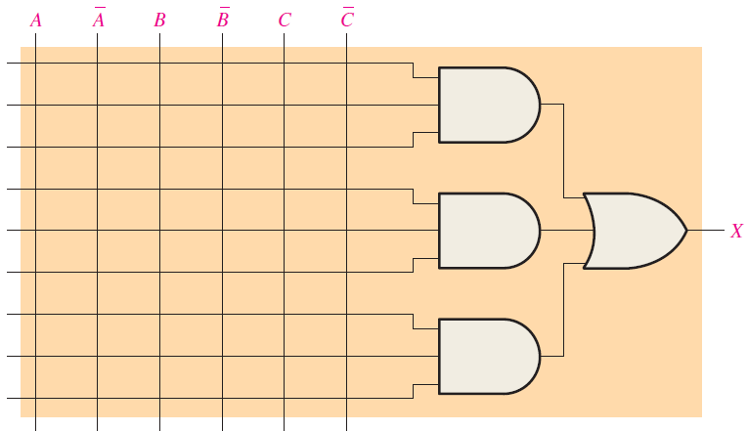
Exercise
Show how the PAL-type array in next Figure should be programmed to implement each of the following SOP expressions. Use an X to indicate a connected link.

Slide 19
References
Null, Linda (2024). "The essentials of computer organization and architecture". 6th edition. Jones & Bartlett Learning, Burlington, Massachusetts. ISBN: 9781284259438..
Thomas L. Floyd. (2014). “Digital Fundamentals”. 11th Edition. Prentice Hall. New Jersey. ISBN: 978-0132737968.
VHDL Tutorial: http://esd.cs.ucr.edu/labs/tutorial/
Introduction to VHDL : https://www.nandland.com/vhdl/tutorials/tutorial-introduction-to-vhdl-for-beginners.html

